Slide 1

AI INTRUSION DETECTION SYSTEM
Leveraging Artificial Intelligence to Detect and Prevent Cyber Threats

Slide 2
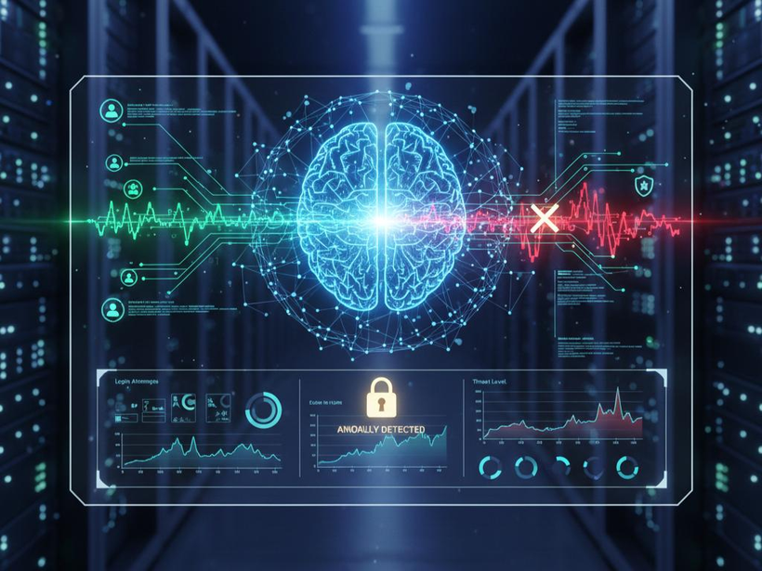
WHAT IS AN INTRUSION DETECTION SYSTEM?
An Intrusion Detection System (IDS) monitors network or system activities.
It identifies unauthorized access and suspicious behavior.
Traditional IDS mainly depends on predefined rules and signatures.
AI-based IDS uses Machine Learning and Artificial Intelligence to detect threats.
It can identify both known and previously unseen attacks.

Slide 3
WHY DO WE NEED AI IN IDS?
Modern cyberattacks are becoming more complex and frequent.
Traditional systems may fail to detect new attack patterns.
AI can analyze a large amount of network traffic quickly.
Machine Learning can identify unusual patterns automatically.
It can reduce false alarms and improve detection accuracy.

Slide 4
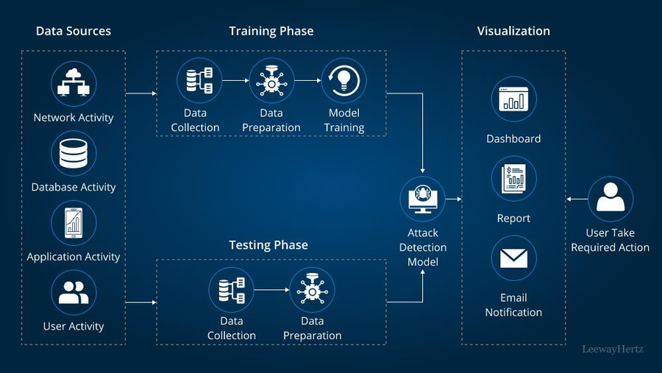
HOW AI-IDS WORKS
Basic Process:
Network Traffic → Data Collection → Preprocessing → AI Model → Attack Detection → Alert
Data Collection: Collects packets, logs, and network activity.
Preprocessing: Removes unnecessary data and prepares features.
AI Model: Analyzes patterns using Machine Learning.
Detection: Classifies activity as normal or malicious.
Alert: Notifies the security administrator about detected threats.

Slide 5
AI TECHNIQUES USED
Machine Learning (ML): Learns patterns from network traffic.
Deep Learning (DL): Handles complex and large datasets.
Decision Trees: Classifies traffic into normal or attack categories.
Random Forest: Combines multiple decision trees for better accuracy.

Slide 6
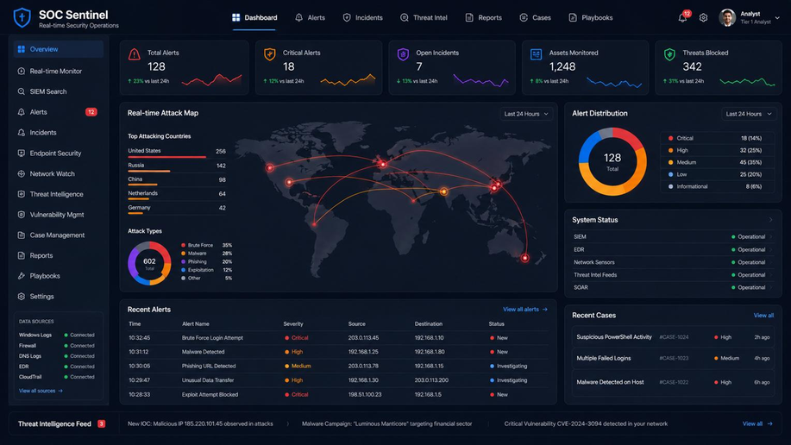
ADVANTAGES & APPLICATIONS
Advantages:
Detects attacks in real time
Identifies unknown threats
Reduces manual monitoring
Applications:
Banking and financial systems
Cloud computing
E-commerce websites

Slide 7
CONCLUSION
AI makes Intrusion Detection Systems smarter and more adaptive.
AI-IDS can detect both known and unknown cyber threats.
Machine Learning helps analyze network behavior and identify anomalies.
It provides faster detection and supports automated security monitoring.
AI-based IDS is an important technology for modern cybersecurity.

Slide 8
THANK YOU

